Slide 1
MANOVA
Dig it!

Slide 2
Comparison to the Univariate
Analysis of Variance allows for the investigation of the effects of a categorical variable on a continuous IV
We can also look at multiple IVs, their interaction, and control for the effects of exogenous factors (Ancova)
Just as Anova and Ancova are special cases of regression, Manova and Mancova are special cases of canonical correlation

Slide 3
Multivariate Analysis of Variance
Is an extension of ANOVA in which main effects and interactions are assessed on a linear combination of DVs
MANOVA tests whether there are statistically significant mean differences among groups on a combination of DVs

Slide 4
MANOVA Example: Examine differences between 2+ groups on linear combinations (V1-V4) of DVs
V1
Pros
V2
Cons
STAGE
(5 Groups
V3
ConSeff
V4
PsySx

Slide 5
MANOVA
A new DV is created that is a linear combination of the individual DVs that maximizes the difference between groups.
In factorial designs a different linear combination of the DVs is created for each main effect and interaction that maximizes the group difference separately.
Also when the IVs have more than two levels the DVs can be recombined to maximize paired comparisons

Slide 6
MANCOVA
The multivariate extension of ANCOVA where the linear combination of DVs is adjusted for one or more continuous covariates.
A covariate is a variable that is related to the DV, which you can’t manipulate, but you want to remove its (their) relationship from the DV before assessing differences on the IVs.

Slide 7
Basic requirements
2 or more continuous DVs
1 or more categorical IVs
MANCOVA you also need 1 or more continuous covariates

Slide 8
Anova vs. Manova
Why not multiple Anovas?
Anovas run separately cannot take into account the pattern of covariation among the dependent measures
  It may be possible that multiple Anovas may show no differences while the Manova brings them out
  MANOVA is sensitive not only to mean differences but also to the direction and size of correlations among the dependents

Slide 9
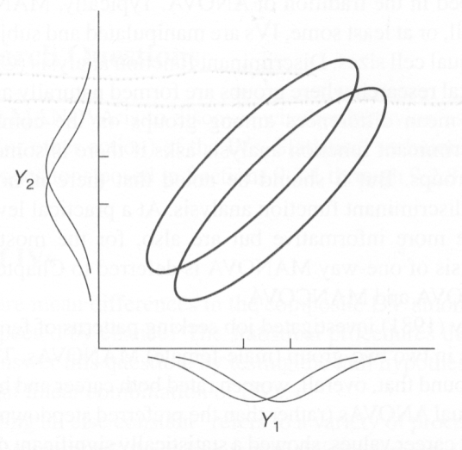
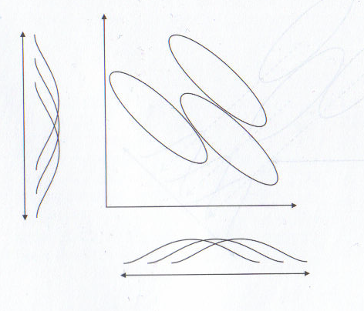
Anova vs. Manova
Consider the following 2 group and 3 group scenarios, regarding two DVs Y₁ and Y₂
If we just look at the marginal distributions of the groups on each separate DV, the overlap suggests a statistically significant difference would be hard to come by for either DV
However, considering the joint distributions of scores on Y₁ and Y₂ together (ellipses), we may see differences otherwise undetectable

Slide 10
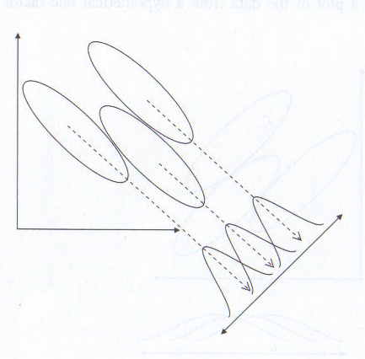
Anova vs. Manova
Now we can look for the greatest possible effect along some linear combination of Y₁ and Y₂
The linear combination of the DVs created makes the differences among group means on this new dimension look as large as possible

Slide 11
Anova vs. Manova
So, by measuring multiple DVs you increase your chances for finding a group difference
  In this sense, in many cases such a test has more power than the univariate procedure, but this is not necessarily true as some seem to believe
Also conducting multiple ANOVAs increases the chance for type 1 error and MANOVA can in some cases help control for the inflation

Slide 12
Kinds of research questions
The questions are mostly the same as ANOVA just on the linearly combined DVs instead just one DV
What is the proportion of the composite DV explained by the IVs?
  What is the effect size?
Is there a statistical and practical difference among groups on the DVs?
Is there an interaction among multiple IVs?
  Does change in the linearly combined DV for one IV depend on the levels of another IV?
  For example: Given three types of treatment, does one treatment work better for men and another work better for women?

Slide 13
Kinds of research questions
Which DVs are contributing most to the difference seen on the linear combination of the DVs?
  Assessment
    Roy-Bargmann stepdown analysis
    Discriminant function analysis
At this point it should be mentioned that one should probably not do multiple Anovas to assess DV importance, although this is a very common practice
  Why?
    Because people do not understand what’s actually being done in a MANOVA, so they can’t interpret it
    They think that MANOVA will protect their familywise alpha rate
    They think the interpretation would be the same and ANOVA is ‘easier’
As mentioned, the Manova regards the linear combination of DVs, the individual Anovas do not take into account DV interrelationships
If you are really interested in group differences on the individual DVs, then Manova is not appropriate

Slide 14
Kinds of research questions
Which levels of the IV are significantly different from one another?
If there are significant main effects on IVs with more than two levels than you need to test which levels are different from each other
  Post hoc tests
And if there are interactions the interactions need to be taken apart so that the specific causes of the interaction can be uncovered
  Simple effects

Slide 15
The MV approach to RM
The test of sphericity in repeated measures ANOVA is often violated
Corrections include:
  adjustments of the degrees of freedom (e.g. Huynh-Feldt adjustment)
  decomposing the test into multiple paired tests (e.g. trend analysis) or
  the multivariate approach: treating the repeated levels as multiple DVs (profile analysis)

Slide 16
Theoretical and practical issues in MANOVA
The interpretation of MANOVA results are always taken in the context of the research design.
  Fancy statistics do not make up for poor design
Choice of IVs and DVs takes time and a thorough research of the relevant literature
As with any analysis, theory and hypotheses come first, and these dictate the analysis that will be most appropriate to your situation.
You do not collect a bunch of data and then pick and choose among analyses to ‘see if you can find something’.

Slide 17
Theoretical and practical issues in MANOVA
Choice of DVs also needs to be carefully considered, and very highly correlated DVs weaken the power of the analysis
Highly correlated DVs would result in collinearity issues that we’ve come across before, and it just makes sense not to use redundant information in an analysis
One should look for moderate correlations among the DVs
  More power will be had when DVs have stronger negative correlations within each cell
  Suggestions are in the .3-.7 range
Choice of the order in which DVs are entered in the stepdown analysis has an impact on interpretation, DVs that are causally (in theory) more important need to be given higher priority

Slide 18
Missing data, unequal samples, number of subjects and power
Missing data needs to be handled in the usual ways
  E.g. estimation via EM algorithms for DVs
  Possible to even use a classification function from a discriminant analysis to predict group membership
Unequal samples cause non-orthogonality among effects and the total sums of squares is less than all of the effects and error added up. This is handled by using either:
  Type 3 sums of squares
    Assumes the data was intended to be equal and the lack of balance does not reflect anything meaningful
  Type 1 sums of square which weights the samples by size and emphasizes the difference in samples is meaningful
  The option is available in the SPSS menu by clicking on Model

Slide 19
Missing data, unequal samples, number of subjects and power
You need more cases than DVs in every cell of the design and this can become difficult when the design becomes complex
If there are more DVs than cases in any cell the cell will become singular and cannot be inverted. If there are only a few cases more than DVs the assumption of equality of covariance matrices is likely to be rejected.
Plus, with a small cases/DV ratio power is likely to be very small and the chance of finding a significant effect, even when there is one, is very unlikely
Some programs are available to purchase that can calculate power for multivariate analysis (e.g. PASS)
You can download a SAS macro here
  http://www.math.yorku.ca/SCS/sasmac/mpower.html

Slide 20
A word about power
While some applied researchers incorrectly believe that MANOVA would always be more powerful than a univariate approach, the power of a Manova actually depends on the nature of the DV correlations
(1) power increases as correlations between dependent variables with large consistent effect sizes (that are in the same direction) move from near 1.0 toward -1.0
(2) power increases as correlations become more positive or more negative between dependent variables that have very different effect sizes (i.e., one large and one negligible)
(3) power increases as correlations between dependent variables with negligible effect sizes shift from positive to negative (assuming that there are dependent variables with large effect sizes still in the design).
Cole, Maxwell, Arvey 1994

Slide 21
Multivariate normality
Assumes that the DVs, and all linear combinations of the DVs are normally distributed within each cell
As usual, with larger samples the central limit theorem suggests normality for the sampling distributions of the means will be approximated
If you have smaller unbalanced designs than the assumption is assessed on the basis of researcher judgment.
The procedures are robust to type I error for the most part if normality is violated, but power will most likely take a hit
Nonparametric methods are also available

Slide 22
Testing Multivariate Normality
R package (Shapiro-Wilk’s/Royston’s H multivariate normality test in R here)
    library(mvnormtest)
    mshapiro.test(t(Dataset)) Or
SAS macro (Mardia’s test)
    http://support.sas.com/ctx/samples/index.jsp?sid=480
However, close examination of univariate situation may at least inform if you you’ve got a problem

Slide 23
Outliers
As usual outlier analysis should be conducted
  To be assessed in every cell of the design
Transformations are available, deletion might be viable if only a relative very few
Robust Manova procedures are out there but not widely available.

Slide 24
Linearity
MANOVA assume linear relationships among all the DVs
MANCOVA assume linear relationships between all covariate pairs and all DV/covariate pairs
Departure from linearity reduces power as the linear combinations of DVs do not maximize the difference between groups for the IVs

Slide 25
Homogeneity of regression (MANCOVA)
When dealing with covariates it is assumed that there is no IV by covariate interaction
One can include the interaction in the model, and if not statistically significant, rerun without
If there is an interaction, (M)ancova is not appropriate
  Implies a different adjustment is needed for each group
Contrast this with a moderator situation in multiple regression with categorical (dummy coded) and continuous variables
In that case we are actually looking for a IV/Covariate interaction

Slide 26
Reliability
As with all methods, reliability of continuous variables is assumed
In the stepdown procedure, in order for proper interpretation of the DVs as covariates the DVs should also have reliability in excess of .8*
Notes:
*I’ve said this many times, current standards for acceptability for reliability estimates held by applied researchers does not match what the methods/quant guys say and have said for eons. I’ve seen some even using subscales with reliability (Cronbach’s alpha) less than .6, which is ridiculous. Lack of reliability hurts every aspect of the statistical analysis, and thus its conclusions. Using unreliable measures greatly impedes scientific progress.

Slide 27
Multicollinearity/Singularity
We look for possible collinearity effects in each cell of the design.
Again, you do not want redundant DVs or Covariates

Slide 28
Homogeneity of Covariance Matrices
This is the multivariate equivalent of homogeneity of variance*
Assumes that the variance/covariance matrix in each cell of the design is sampled from the same population so they can be reasonably pooled together to create an error term
  Basically the HoV has to hold for the groups on all DVs and the correlation between any two DVs must be equal across groups
If sample sizes are equal, MANOVA has been shown to be robust (in terms of type I error) to violations even with a significant Box’s M test
  It is a very sensitive test as is and is recommended by many not to be used
Notes:
*You saw this for standard mixed designs with between groups factors and repeated measures.

Slide 29
Homogeneity of Covariance Matrices
If sample sizes are unequal then one could evaluate Box’s M test at more stringent alpha. If significant, a violation has probably occurred and the robustness of the test is questionable
If cells with larger samples have larger variances than the test is most likely robust
to type I error
  though at a loss of power (i.e. type II error increased)
If the cells with fewer cases have larger variances than only null hypotheses are retained with confidence but to reject them is questionable.
  i.e. type I error goes up
  Use of a more stringent criterion (e.g. Pillai’s criteria instead of Wilk’s)

Slide 30
Different Multivariate test criteria
Hotelling’s Trace
Wilk’s Lambda,
Pillai’s Trace
Roy’s Largest Root
What’s going on here? Which to use?

Slide 31
The Multivariate Test of Significance
Thinking in terms of an F statistic, how is the typical F calculated in an Anova calculated?
As a ratio of B/W (actually mean b/t sums of squares and within sums of squares)
Doing so with matrices involves calculating* BW⁻¹
We take the between subjects matrix and post multiply by the inverted error matrix
Notes:
*Often you will see T = H + E, where H stands for hypothesis sums of squares, and E error sums of squares. In that case we’d have HE⁻¹

Slide 32
Example
Psy Program Silliness Pranksterism
1 8 60
1 7 57
1 13 65
1 15 63
1 12 60
2 15 62
2 16 66
2 11 61
2 12 63
2 16 68
3 17 52
3 20 59
3 23 59
3 19 58
3 21 62
Dataset example
1: Experimental
2: Counseling
3: Clinical

Slide 33
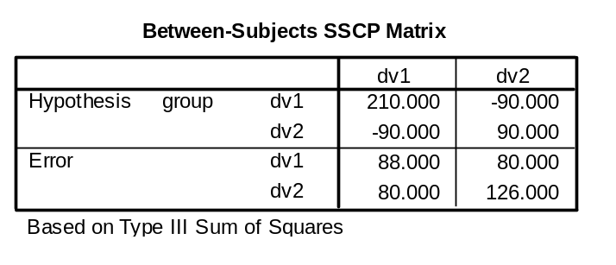
Example
To find the inverse of a matrix one must find the matrix such that A⁻¹A = I where I is the identity matrix
  1s on the diagonal, 0s on the off diagonal
For a two by two matrix it’s not too bad
← B matrix
← W matrix

Slide 34
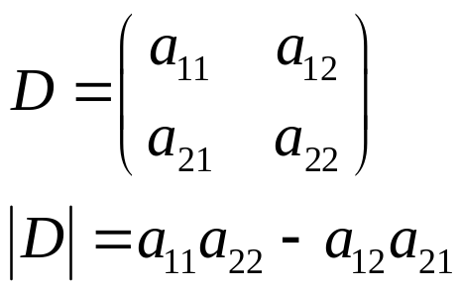
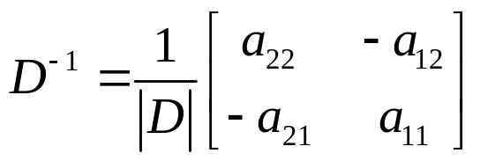
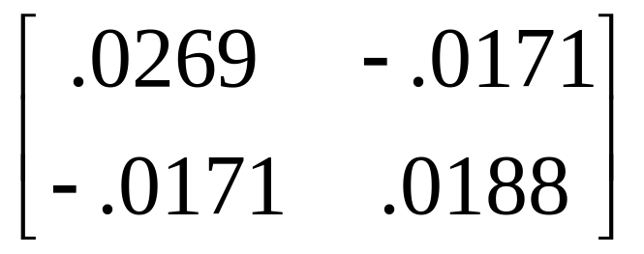
Example
We find the inverse by first finding the determinate of the original matrix and multiply its inverse by the ‘adjoint’ of that matrix of interest*
Our determinate here is 4688 and so our result for W⁻¹ is
You might for practice verify that multiplying this matrix by W will result in a matrix
of 1s on the diagonal and zeros off-diagonal
Notes:
*If you’d like the easier way to do it, here is how to in R:
Wmatrix=matrix(c(88,80,80,126), ncol=2)
solve(Wmatrix)

Slide 35
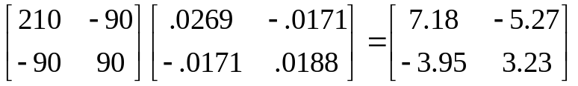
Example
With this new matrix BW⁻¹, we could find the eigenvalues and eigenvectors associated with it.*
For more detail and a different understanding of what we’re doing, click the icon; for some the detail helps.
For the more practically minded just see the R code below
The eigenvalues of BW⁻¹ are (rounded):
  10.179 and 0.226
Notes:
Here’s what I’ve done so far in R:
Bmatrix=matrix(c(210,-90,-90,90), ncol=2)
Wmatrix=matrix(c(88,80,80,126), ncol=2)
Tmatrix=Bmatrix+Wmatrix
Wmatinvers= solve(Wmatrix)
newmat=Bmatrix%*%Wmatinvers
eigen(newmat)

Slide 36
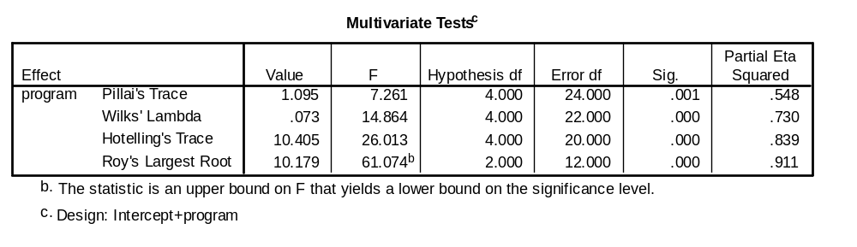
Let’s get on with it already!
So?
Let’s examine the SPSS output for that data
Analyze/GLM/Multivariate

Slide 37
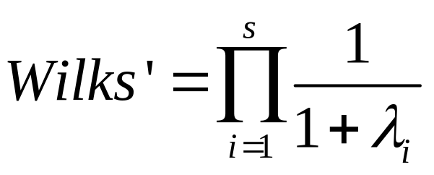
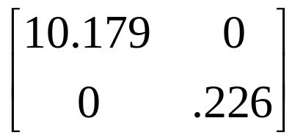
Wilks’ and Roy’s
We’ll start with Wilks’ lamda
It is calculated as we presented before |W|/|T| = .0729
It actually is the product of the inverse of the eignvalues+1
(1/11.179)*(1/1.226) =.073
Next, take a gander at the value of Roy’s largest root
It is the largest eigenvalue of the BW⁻¹ matrix
  The word root or characteristic root is often used for the word eigenvalue

Slide 38
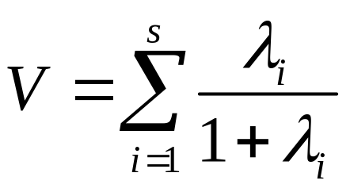
Pillai’s and Hotelling’s
Pillai’s trace is actually the total of our eigenvalues for the BT⁻¹ matrix*
  Essentially the sum of the variance accounted in the variates
Here we see it is the sum of the eigenvalue/1+eigenvalue ratios
  10.179/11.179 + .226/1.226 = 1.095
Now look at Hotelling’s Trace
It is simply the sum of the eigenvalues of our
  10.179 + .226 = 10.405
Notes:
*Assuming you’ve already done the previous code:
eigen(Bmatrix%*%solve(Tmatrix))

Slide 39
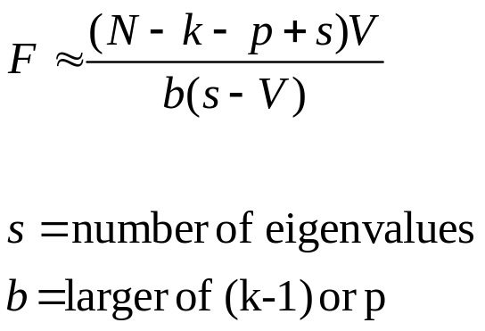
Statistical Significance
Comparing the approximate F for Wilks and Pillai
Wilks is calculated as discussed with canonical correlation
For Pillai’s it is

Slide 40
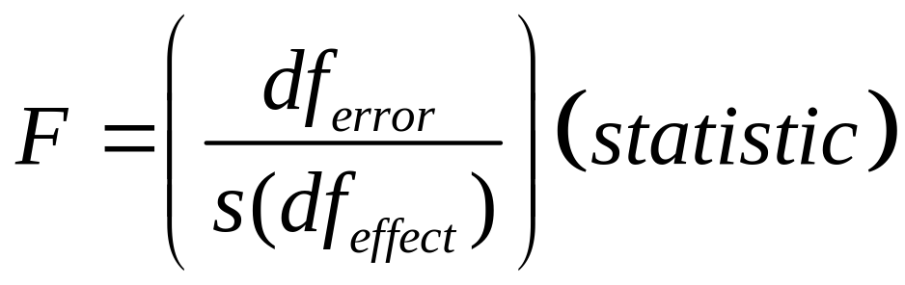
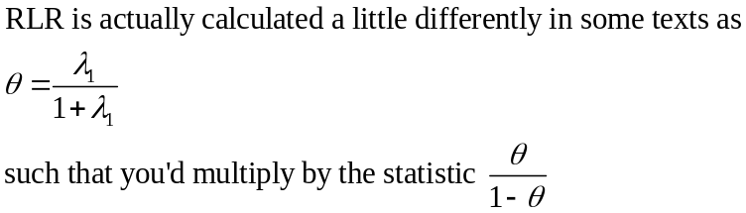
Statistical Significance
Hotelling-Lawley Trace and Roy’s Largest Root* from SPSS:
s is the number of eigenvalues of the BW⁻¹ matrix (smaller of k-1 vs. p number of DVs)
  Again, think of cancorr
Note that s is the number of eigenvalues involved, but for Roy’s greatest root there is only 1 (the largest)

Slide 41
Different Multivariate test criteria
When there are only two levels for an effect that s = 1 and all of the tests will be identical
When there are more than two levels the tests should be close but may not all be similarly sig or not sig

Slide 42
Different Multivariate test criteria
As we saw, when there are more than two levels there are multiple ways in which the data can be combined to separate the groups
Wilk’s Lambda, Hotelling’s Trace and Pillai’s trace all pool the variance from all the dimensions to create the test statistic.
Roy’s largest root only uses the variance from the dimension that separates the groups most (the largest “root” or difference).

Slide 43
Which do you choose?
Wilks’ lambda is the traditional choice, and most widely used
Wilks’, Hotelling’s, and Pillai’s have shown to be robust (type I sense) to problems with assumptions (e.g. violation of homogeneity of covariances), Pillai’s more so, but it is also the most conservative usually.
Roy’s is the more liberal test usually (though none are always most powerful), but it loses its strength when the differences lie along more than one dimension
  Some packages will even not provide statistics associated with it
However in practice differences are often seen mostly along one dimension, and Roy’s is usually more powerful in that case (if HoCov assumption is met)

Slide 44
Guidelines from Harlow
Generally Wilks
The others:
  Roy’s Greatest Characteristic Root:
    Uses only largest eigenvalue (of 1st linear combination)
    Perhaps best with strongly correlated DVs
  Hotelling-Lawley Trace
    Perhaps best with not so correlated DVs
  Pillai’s Trace:
    Most robust to violations of assumption

Slide 45
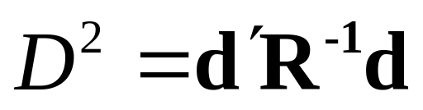
Multivariate Effect Size*
While we will have some form of eta-squared measure, typically when comparing groups we like a standardized mean difference
  Cohen’s d
Mahalanobis Generalized Distance
  Multivariate counterpart
  Expresses in a squared metric the distance between the group centroids (the vectors of univariate means)
d is the row/column vector of Cohen’s d for the individual outcome variables, R is the pooled within-groups correlation matrix
Click the smiley for some more technical detail
Notes:
*You should download the Kline addendum on the website for your records

Slide 46
Post-hoc analysis
If the multivariate test chosen is significant, you’ll want to continue your analysis to discern the nature of the differences.
A first step would be to check the plots of mean group differences for each DV
Graphical display will enhance interpretability and understanding of what might be going on, however it is still in ‘univariate’ mode

Slide 47
Post-hoc analysis
Many run and report multiple univariate F-tests (one per DV) in order to see on which DVs there are group differences; this essentially assumes uncorrelated DVs.
For many this is the end goal, and they assume that running the Manova controls for type I error among the individual tests
  Known as the ‘protected F’
It doesn’t except when:
  The null hypothesis is completely true
    Which no one ever does follow-ups for
  The alternative hypothesis is completely true
    In which case there is no possibility for a type I error
  The null is true for only one outcome
In short if your goal is to maintain type I error for multiple uni Anovas, then just do a Bonferonni/FDR type correction for them

Slide 48
Post-hoc analysis
Furthemore if the DVs are correlated (as would be the reason for doing a Manova) then individual F-tests do not pick up on this, hence their utility of considering the set of DVs as a whole is problematic
If for example two tests were significant, one would be interpreting them as though the groups were different on separate and distinct measures, which may not be the case

Slide 49
Multiple pairwise contrasts
In a one-way setting one might instead consider performing the pairwise multivariate contrasts, i.e. 2 group MANOVAs
  Hotelling’s T²
Doing so allows for the detail of individual comparisons that we usually want
However type I error is a concern with multiple comparisons, so some correction would still be needed
  E.g. Bonferroni, False Discovery Rate

Slide 50
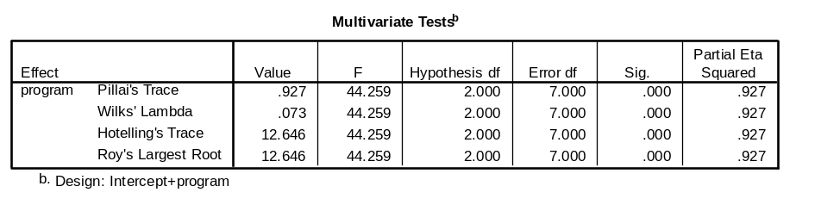
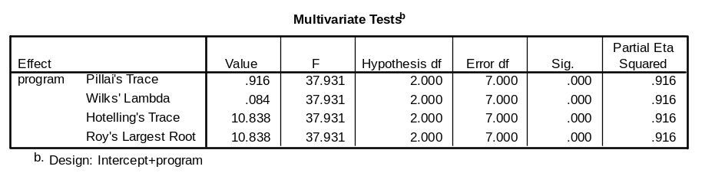
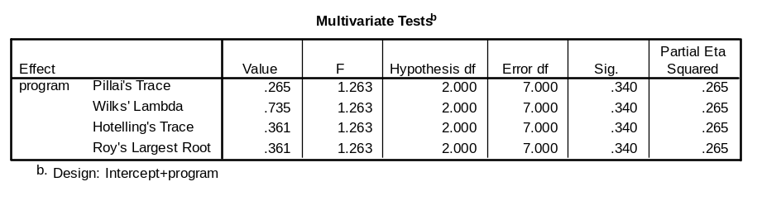
Multiple pairwise contrasts
Example*
Counseling vs. Clinical
  Sig
Experimental vs. Clinical
  sig
Experimental vs. Counseling
  Nonsig
So it seems the clinical folk are standing apart in terms of silliness in chicanery
How so?
Notes:
*Note that as mentioned previously, with two groups the significance tests are identical and there is no reason to prefer one or the other.

Slide 51
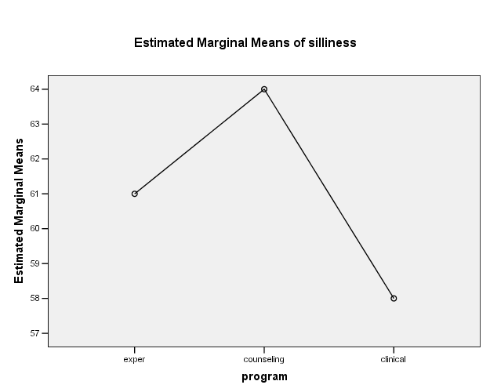
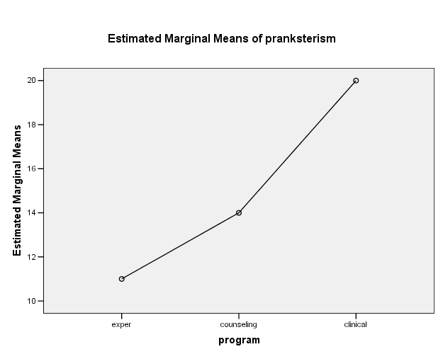
Multiple pairwise contrasts
Consult the graphs on individual DVs
Seems that although they are not as silly in general, the clinical folk are more prone to hijinks.
  Pranksterism is serious business!

Slide 52
Multiple pairwise contrasts
Note that for each multivariate t-test, we will have different linear combinations of DVs created for each comparison*, as the combinations maximize the difference between the groups being compared
So for one comparison you might have most of the difference along one variable, and for another an equal combination of multiple DVs
At this point you might now consult the univariate results to aid in your interpretation, as we did with the graphs
Also you might consider, as we did with the one-way Anova review, if the omnibus test is even necessary
Notes:
*When only 2 groups there is only one linear combination of DVs possible.

Slide 53
Assessing Differences on the Linear Combination
Perhaps the best approach is to conduct your typical post hocs on the composite of the DVs itself, especially as that is what led to the significant omnibus outcome in the first place*
Statistical programs will either provide the coefficients to create them or save the composites outright, making this easy to do
Notes:
*Interestingly, as the statistical tests for the approximate F involve different calculations to derive the F statistic in the univariate test, you might actually have a statistically significant result for the latter but not the former even though the differences in degrees of freedom would suggest a less powerful test in the univariate case. Perhaps this is a good example of why to not have an arbitrary stat sig cutofff, but rather a range or ‘neighborhood’ of statistical or practical significance.

Slide 54
Assessing DV importance
Our previous discussion focused on group differences
We might instead or also be interest in individual DV contribution to the group differences
While in some cases univariate analyses may reflect DV importance in the multivariate analysis, better methods/approaches are available

Slide 55
Discriminant Function Analysis
We will approach DFA more after finishing up Manova, but we’ll talk about its role here
One can think of DFA as reverse Manova
It uses group membership as the DV and the Manova DVs as predictors of group membership*
Using this as a follow up to MANOVA will give you the relative importance of each DV predicting group membership (in a multiple regression sense)
Notes:
*Here is how to think of DFA. First, as we have said MANOVA is a special case of cancorr in which one of the sets of variables contains dummy-coded variables representing group membership. Now, would the actual cancorr, which we identified as largely a descriptive procedure, ‘care’ which side had the coded variables in calculating the correlation? It would not. As such MANOVA and DFA are mathematically equivalent.

Slide 56
DFA
In general DFA is appropriate for:
  Separation between k groups
  Discrimination with respect to dimensions and variates
  Estimation of the relationship between p variables and k group membership variables
  Classifying individuals to specific populations
The first three pertain more to our Manova setting, and DFA can thus provide information concerning
  Minimum number of dimensions that underlie the group differences on the p variables
  How the individuals relate to the underlying dimensions and the other variables
  Which variables are most important for group separation

Slide 57
DFA
A common approach to interpreting the discriminant function is to check the standardized coefficients
  Analogous to standardized (beta) weights in MR
Due to this we have all those same concerns of collinearity, outliers, suppression etc.
If the p variables are highly correlated, their relative importance may be split, or one given a large weight and the other a small weight, even if both may discriminate among the groups equally
Note also that these are partial coefficients, again, just being the same as your MR betas (though canonical versions)

Slide 58
DFA
Some suggest that interpreting the correlations of the p variables and the discriminant function (i.e. their loadings as we called them for cancorr) as studies suggest they are more stable from sample to sample
So while the weights give an assessment of unique contribution, the loadings can give a sense of how much correlation a variable has with the underlying composite

Slide 59
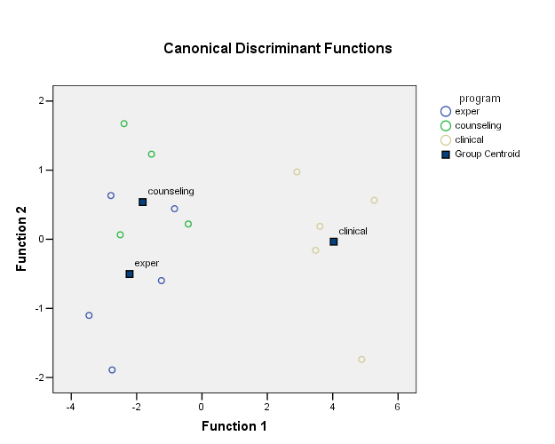
DFA
Stepwise methods are available for DFA
But utilizing such an approach as a method for analyzing a Manova in a post-hoc fashion misses out on the consideration of the variables as a set

Slide 60
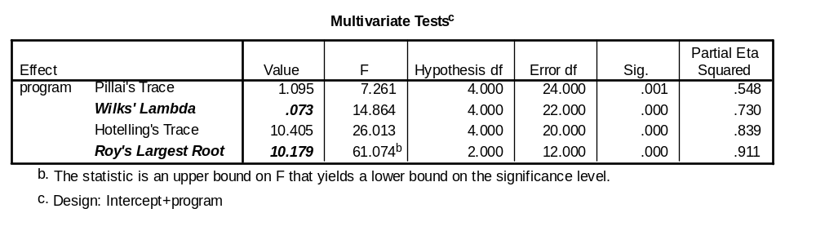
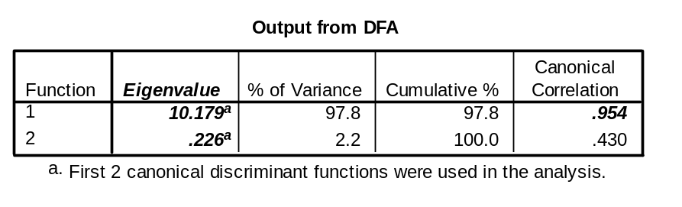
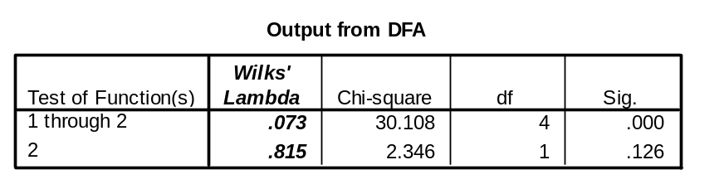
DFA, Manova, Cancorr
Keep in mind that we are still basically employing a canonical correlation each time
Some of the exact same output will surface in each
The technique chosen is one of preference with regard to the type of interpretation involved and goal of the research.
Canonical Correlation output
1 .954
2 .430
Test that remaining correlations are zero:
Wilk's Chi-SQ DF Sig.
1 .073 30.108 4.000 .000
2 .815 2.346 1.000 .126

Slide 61
Assessing DVs
The Roy-Bargman step down procedure is another method that can be used as a follow-up to MANOVA to assess DV importance or as alternative to it all together.
If one has a theoretical ordering of DV importance, then this may be the method of choice

Slide 62
Roy-Bargman
Roy-Bargman step down procedure
  The theoretically most important DV is analyzed as an individual univariate test (DV1).
  The next DV (DV2) in terms of theoretical importance is then analyzed using DV1 as a covariate. This controls for the relationship between the two DVs.
  DV3 (in terms of importance) is assessed with DV1 and DV2 as covariates, etc.
At each step you are asking: are there group differences on this DV controlling for the other DVs?
In a sense this is a like a stepwise DFA, but here we have a theoretical reason for variable entry rather than some completely empirically based criterion
Also, one will want to control type I error for the number of tests involved
The stepdown analysis is available in SPSS ‘Manova’ syntax

Slide 63
Specific Comparisons and Trend Analysis
If one has a theoretical (a priori) basis of how the group differences are to be compared planned contrasts or trend analysis can be conducted in the multivariate setting
  E.g. Maybe you thought those clinical types were weirdos all along
Note that all the post-hocs and contrasts in the SPSS menu for MANOVA regard the univariate Anovas, not the Manova
Planned comparisons will require SPSS syntax

Slide 64
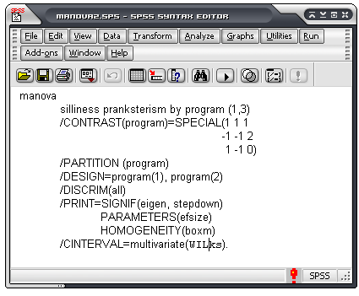
Specific Comparisons and Trend Analysis
Here is some example syntax that will result in a little bit of much of what we’ve talked about so far.
This will conduct the a priori tests of clinical vs. others, and experimental vs. counseling
Afterwards the full design, with DFA and stepdown procedures incorporated

Slide 65
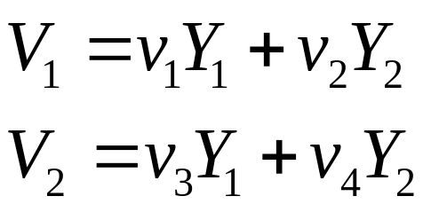
Example
With this new matrix BW⁻¹, we could find the eigenvalues and eigenvectors associated with it.*
We can use the values of the eigenvectors as coefficients in calculating a new variate
  Recall cancorr
Notes:
Here’s what I’ve done so far in R:
Bmatrix=matrix(c(210,-90,-90,90), ncol=2)
Wmatrix=matrix(c(88,80,80,126), ncol=2)
Wmatinvers= solve(Wmatrix)
newmat=Bmatrix%*%Wmatinvers
eigen(newmat)

Slide 66
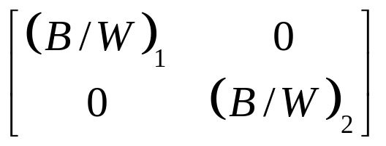
Example
Using the variate scores, this would give us a new BW⁻¹ matrix, a diagonal matrix (zeros for the off-diagonals)
Each value on the diagonal is now the BW⁻¹ ratio for the first variate pair and the second variate pair

Slide 67
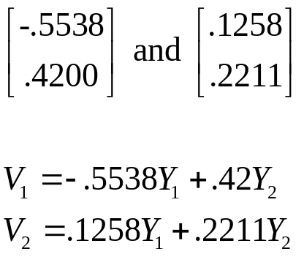
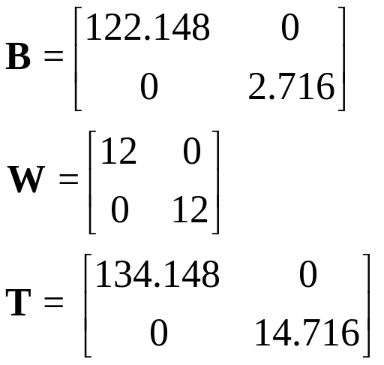
Example
For our example:
We calculate new scores for each person, and then get the B, W, and T matrices again
Cripes! Where is this going??

Slide 68
Example
Here, finally, is our new BW⁻¹ matrix
Each diagonal element is simply the SS_{b} for the Variate divided by its SS_{w}
The larger they are then, the greater the difference between the groups on that variate
It turns out they are the eigenvalues for the original BW⁻¹ matrix

Slide 69
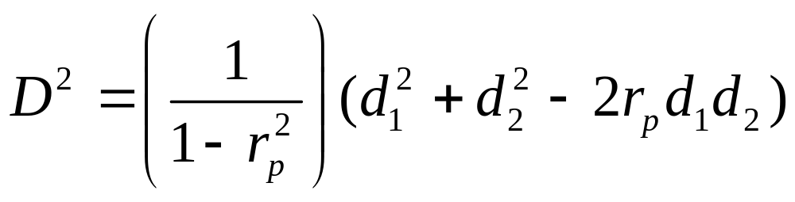
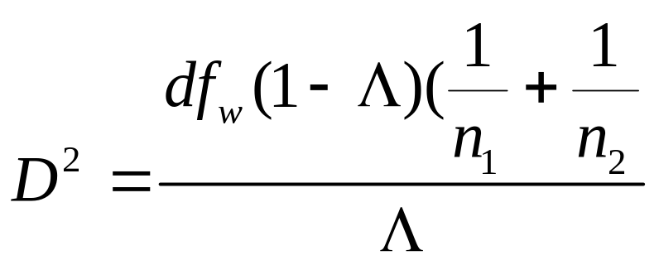
Generalized distance
If only 2 DVs and 2 groups then
For more than 2 DVs

Slide 70
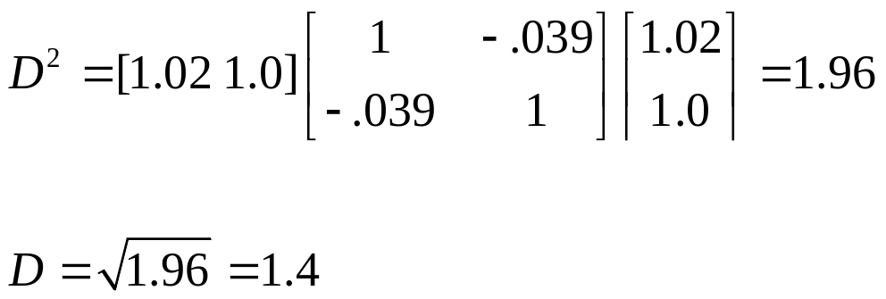
Generalized distance
From the example, comparing groups 1 and 2
The basic idea/approach is the same in dealing with specific contrasts, but for details see Kline 2004 supplemental.

